Slide 1
Bayesian Learning

Slide 2
Bayes Classifiers
Credit rating prediction:
Training data: Joint observation of features and outcome
Classifier is a mapping from observed values of x to predicted values of c
Features | # bad | #good
x=0 | 42 | 15
x=1 | 338 | 287
X=2 | 3 | 5

Slide 3
Predict more likely outcome for each possible observation
Probability of outcome c given an observation x
Features | # bad | #good
x=0 | .7368 | .2632
x=1 | .5408 | .4592
X=2 | .3750 | .6250

Slide 4
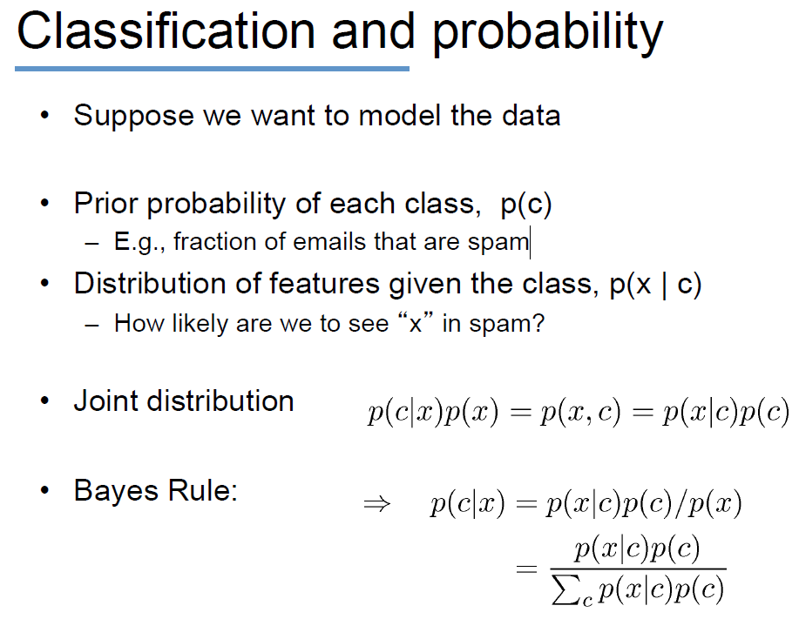
How likely we see ‘x’ in users with good credit

Slide 5
Bayes Classifiers
Features | # bad | #good
x=0 | .7368 | .2632
x=1 | .5408 | .4592
X=2 | .3750 | .6250
Features | # bad | #good
x=0 | 42 | 15
x=1 | 338 | 287
X=2 | 3 | 5
P(x/c=0) | P(x/c=1)
42/383 | 15/307
338/383 | 287/307
3/383 | 5/307
P(c) 383/690 307/690
P(x)= 57/690
P(x)= (42/383)(383/690)+(15/307)(307/690)=57/690
= P(x/c=0*p(c=0)+ P(x/c=1)*p(c=1)

Slide 6
Bayesian Learning (Based on Chapter 6 of Mitchell T.., Machine Learning,)
Bayesian Decision Theory came long before Decision Tree Learning and Neural Networks. It was studied in the field of Statistical Theory and more specifically, in the field of Pattern Recognition.
Bayesian Decision Theory is at the basis of important learning schemes such as the Naïve Bayes Classifier, Learning Bayesian Belief Networks and the EM Algorithm.
Bayesian Decision Theory is also useful as it provides a framework within which many non-Bayesian classifiers can be studied (See [Mitchell, Sections 6.3, 4,5,6]).

Slide 7
Bayes Theorem
Goal: To determine the most probable hypothesis, given the data D plus any initial knowledge about the prior probabilities of the various hypotheses in H.
Prior probability of h, P(h): it reflects any background knowledge we have about the chance that h is a correct hypothesis (before having observed the data).
Prior probability of D, P(D): it reflects the probability that training data D will be observed given no knowledge about which hypothesis h holds.
Conditional Probability of observation D, P(D|h): it denotes the probability of observing data D given some world in which hypothesis h holds.

Slide 8
Bayes Theorem
Posterior probability of h, P(h|D): it represents the probability that h holds given the observed training data D. It reflects our confidence that h holds after we have seen the training data D and it is the quantity that Machine Learning researchers are interested in.
Bayes Theorem allows us to compute P(h|D):
P(h|D)=P(D|h)P(h)/P(D)

Slide 9
Maximum A Posteriori (MAP) Hypothesis and Maximum Likelihood
Goal: To find the most probable hypothesis h from a set of candidate hypotheses H given the observed data D.
MAP Hypothesis, h_{MAP} = argmax _{h∈H} P(h|D)
= argmax _{h∈H} P(D|h)P(h)/P(D)
= argmax _{h∈H} P(D|h)P(h)
If every hypothesis in H is equally probable a priori, we only need to consider the likelihood of the data D given h, P(D|h). Then, h_{MAP} becomes the Maximum Likelihood,
h_{ML}= argmax _{h∈H} P(D|h)
This can be applied to any set H of mutually exclusive propositions whose probabilities sum to 1.

Slide 10
Bayes’ Rule
Who is who in Bayes’ rule

Slide 11
Bayesian classifiers
unseen sample X = <rain, hot, high, weak>
P(p|a₁,a₂,..,a_{n}) = a
P(v_{j}|a₁,a₂,..,a_{n})
P(n|a₁,a₂,..,a_{n}) =b
If a> b, then the class of X is p otherwise n

Slide 12
Naïve Bayes Classifier
Let each instance x of a training set D be described by a conjunction of n attribute values <a₁,a₂,..,a_{n}> and let f(x), the target function, be such that f(x) ∈ V, a finite set.
Bayesian Approach:
v_{MAP} = argmax_{vj∈ V} P(v_{j}|a₁,a₂,..,a_{n})
= argmax_{vj∈ V} [P(a₁,a₂,..,a_{n}|v_{j}) P(v_{j})/P(a₁,a₂,..,a_{n})]
= argmax_{vj∈ V} [P(a₁,a₂,..,a_{n}|v_{j}) P(v_{j})
Naïve Bayesian Approach: We assume that the attribute values are conditionally independent so that P(a₁,a₂,..,a_{n}|v_{j}) =∏_{i} P(a₁|v_{j})
Naïve Bayes Classifier:
v_{NB} = argmax_{vj∈ V} P(v_{j}) ∏_{i} P(a_{i}|v_{j})

Slide 13
Naïve Bayesian Classification
If i-th attribute is categorical: P(a₁,a₂,..,a_{n}|v_{j}) is estimated as the relative freq of samples having value a_{i} as i-th attribute in class v
If i-th attribute is continuous: P(a₁,a₂,..,a_{n}|v_{j}) is estimated thru a Gaussian density function
Computationally easy in both cases

Slide 14
Play-tennis example: estimating P(x_{i}|C)
outlook
P(sunny|p) = 2/9
P(sunny|n) = 3/5
P(overcast|p) = 4/9
P(overcast|n) = 0
P(rain|p) = 3/9
P(rain|n) = 2/5
temperature
P(hot|p) = 2/9
P(hot|n) = 2/5
P(mild|p) = 4/9
P(mild|n) = 2/5
P(cool|p) = 3/9
P(cool|n) = 1/5
humidity
P(high|p) = 3/9
P(high|n) = 4/5
P(p) = 9/14
P(normal|p) = 6/9
P(normal|n) = 2/5
P(n) = 5/14
windy
P(true|p) = 3/9
P(true|n) = 3/5
P(false|p) = 6/9
P(false|n) = 2/5

Slide 15
Naive Bayesian Classifier (II)
Given a training set, we can compute the probabilities

Slide 16
Play-tennis example: classifying X
An unseen sample X = <rain, hot, high, false>
P(X|p)·P(p) = P(rain|p)·P(hot|p)·P(high|p)·P(false|p)·P(p) = 3/9·2/9·3/9·6/9·9/14 = 0.010582
P(X|n)·P(n) = P(rain|n)·P(hot|n)·P(high|n)·P(false|n)·P(n) = 2/5·2/5·4/5·2/5·5/14 = 0.018286
Sample X is classified in class n (don’t play)

Slide 17
The independence hypothesis…
… makes computation possible
… yields optimal classifiers when satisfied
… but is seldom satisfied in practice, as attributes (variables) are often correlated.
Attempts to overcome this limitation:
Bayesian networks, that combine Bayesian reasoning with causal relationships between attributes

Slide 18
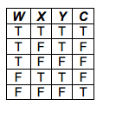
The following dataset is given where there are three Boolean attributes, W, X and Y, and one Boolean class variable, C:
How would a Naïve Bayes Classifier classify the test example (W=F, X=T,Y=F)?

Slide 19
The following dataset is given where there are three Boolean attributes, W, X and Y, and one Boolean class variable, C:
How would a Naïve Bayes Classifier classify the test example (W=F, X=T,Y=F)?

Slide 20
The following dataset is given where there are three Boolean attributes, W, X and Y, and one Boolean class variable, C:
How would a Naïve Bayes Classifier classify the test example (W=F, X=T,Y=F)?

